Slide 1

Welcome to
Your instructors:
Abhi: as5460@columbia.edu
Sam: sl4742@columbia.edu
Sharon: sjs2290@columbia.edu
Please take a moment to introduce yourself to your tablemates!

Slide 2
>Week 1:
Getting comfortable

Slide 3
Today’s agenda
Introductions
Course Structure
Terminal Overview
Git Overview & Tutorial
Jupyter Notebook Tutorial

Slide 4
Why are we here and what are our goals?
Learn Python
Get general coding experience
Want to:
Analyze data
Learn what’s possible with Python
Set up a new pipeline
Work on a CRISPR dataset
Analyzing behavioral + imaging data

Slide 5
Our goals for you:
We want you to set up Python for your own use + learn coding basics
We want you to know what basic packages/tools are necessary to succeed with Python in a neuro lab environment
We want you to feel confident learning to learn Python
We want you to be able to share and understand code

Slide 6
Course Structure
Our syllabus is available on the github - subject to change
Weeks 1-4: getting set up + python basics
Weeks 5-7: data analysis and visualization
Weeks 8-9: navigating packages + advanced python/ML
Week 10-fin: final projects!
Start thinking about what you’d like to do - details to be released later

Slide 7
How will class work?
Combination of lectures, live coding, and exercises
Practice via homework and challenge problems
Sticky system:
Pink sticky = go
Orange sticky = help
Help us help you - fill out exit tickets at the end of class.
Talk to us, anytime! Small coding problems, package issues, etc. - the sooner the better :) We are here to help no matter what.

Slide 8
Logistics and registration
We only have 30 slots - if you are a student you need to register officially. Instructor approval is coming soon, just sign up!
Postdocs and techs are ‘NRA students’
We will reach out to you this week if we have too many folks - if you know you are not interested, please let us know today so we can have a better idea of numbers!
Please note that the official deadline to drop this class is October 8.
If you want to take part in class you must attend every class in-person, unless you have an excused absence. With limited slots, we have to reserve space for students that are committed/will gain the most from the course.
Come talk to us! (also fill out the sign-up form)

Slide 9
TLDR:
Courseworks
Sign-up form
Slack
Come to class :)

Slide 10
How can I get help?
Your peers
Slack us!
Email us!
Office hours: before or after class - we have the room booked until 12-3PM (we can do by appointment if needed)
Talk to us, anytime! Small coding problems, package issues, etc. - the sooner the better :) We are here to help no matter what.

Slide 11
Terminal Overview
What is a terminal?
Why are there so many terminals??
Notes:
11:00AM
Note to speak slowly

Slide 12
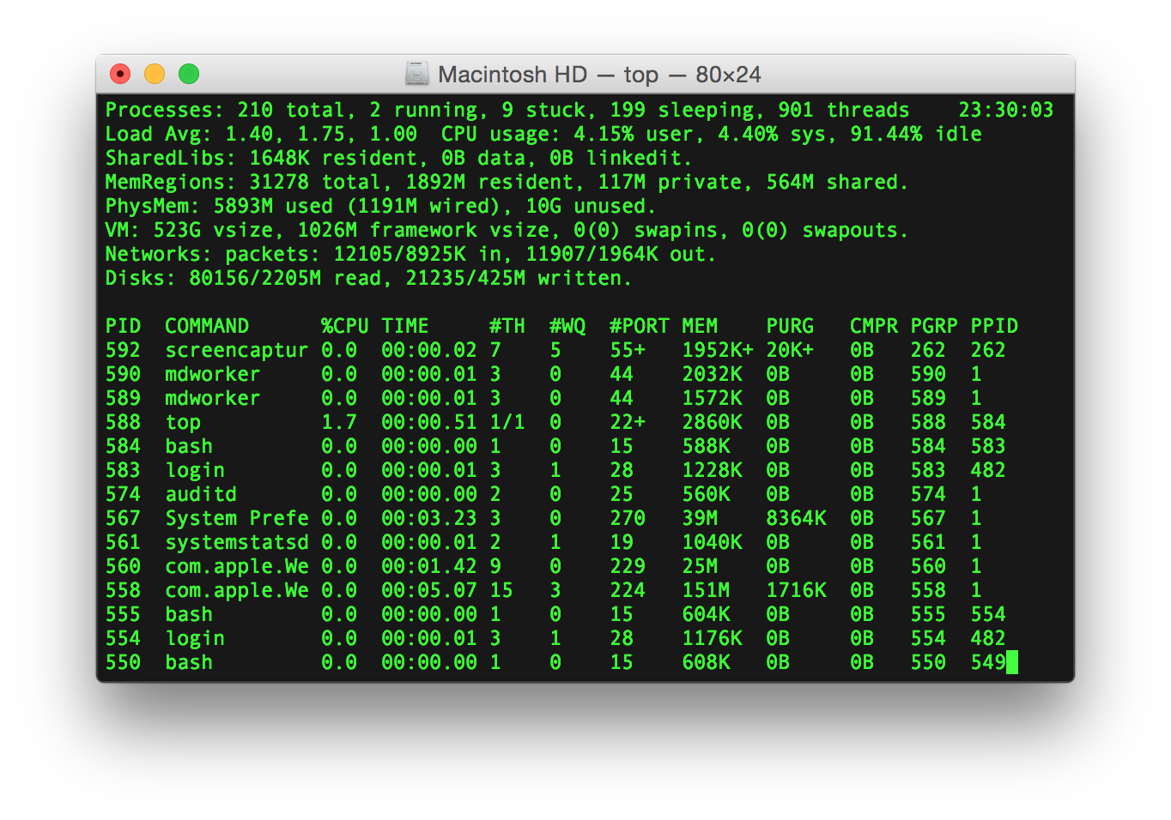
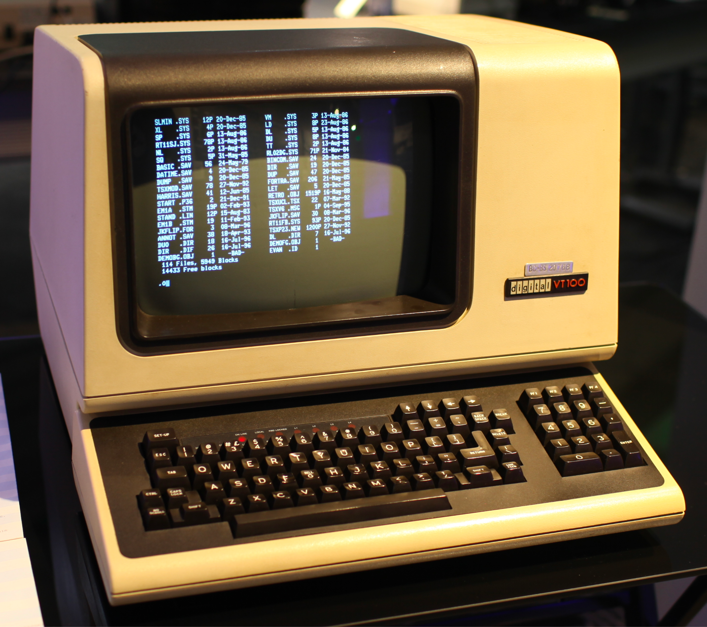
Terminal Overview
Terminals are a text input and output program that allows you to talk to your hardware and tell it what to do
Input (what you type) and output (what shows up)
Fun Fact: Back in the day, the entire way you would interact with your computer would be through a physical terminal. The terminals we use nowadays are actually considered terminal emulators
then vs now
Notes:
Terminals are a text input and output program that allows you to talk to your hardware, i.e. your computer, and tell it what to do. It translates your written text into something that is machine readable
Back in the day, the entire way you would interact w/ your comp would be thru a physical terminal. So, no nice operating systems with user interfaces or anything like that, just straight terminals. The terminals we use nowadays are actually considered terminal emulators
11:01AM

Slide 13
Terminal Overview - shells
Terminals each have their own shells
A shell is a program that processes commands and outputs the results.
It interprets and processes the commands entered by the user via the terminal.
Notes:
11:07AM

Slide 14
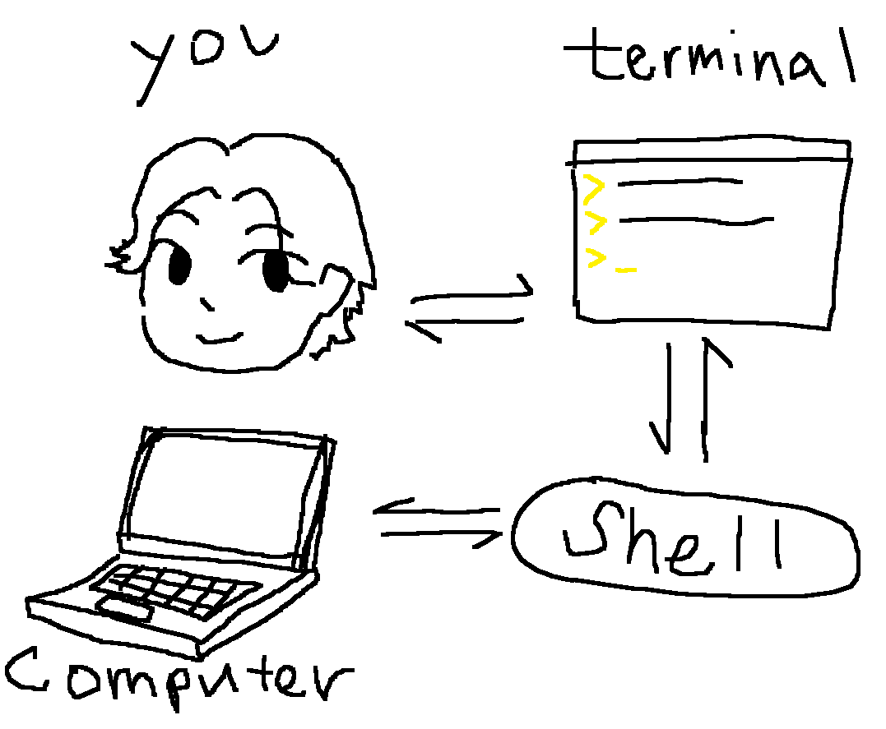
Terminal Overview
me
Linux/Mac shell: Bash or Zsh
Windows: Powershell
I know it’s confusing, but sometimes your terminal name is the same as your shell, and sometimes it isn’t.
You can just think of the terminal as your keyboard and monitor, and your shell as the underlying software.
Notes:
11:07

Slide 15
Terminal Overview - Misc
Directories: fancy word for folders. Every file in your computer is contained within a hierarchical set of directories
Application: a program, or a set of instructions that tells a computer what to do.
Your computer doesn’t directly understand human-readable code, so applications are code that is compiled into a language that is easier for your computer to understand.
As a scripting language, python is even more quirky, but we won’t get into that.
Notes:
Compile refers to the act of converting programs written in high level programming language, which is understandable and written by humans, into a low level binary language understood only by the computer.
To compile, you need a compiler, which is a software program that converts high level programming language code into machine code.
Applications are executable programs that have been translated from human-readable code into machine code.

Slide 16

Ok, but what is a Git?
Git is a Version Control System (VCS).
Glad that cleared things up!
Notes:
11:15

Slide 17
What even is a Git?
Git is a Version Control System (VCS).
It allows you to see changes you make to your code and easily revert them.
Notes:
11:15

Slide 18
What even is a Git?
Git is a Version Control System (VCS).
It allows you to see changes you make to your code and easily revert them.
It was designed to make it easier to have multiple versions of a code base, sometimes across multiple developers or teams
Notes:
11:16

Slide 19
What even is a Git?
Git is a Version Control System (VCS).
It allows you to see changes you make to your code and easily revert them.
It was designed to make it easier to have multiple versions of a code base, sometimes across multiple developers or teams
It is NOT GitHub though!
Notes:
11:16AM

Slide 20

Ok what is Github then?
Github.com is a website that hosts git repositories on a remote server
Hosting repositories on Github facilitates the sharing of codebases among teams by providing a nice user-friendly GUI (graphical user interface) to understand what changes have been made and by whom.
Notes:
11:16AM

Slide 21
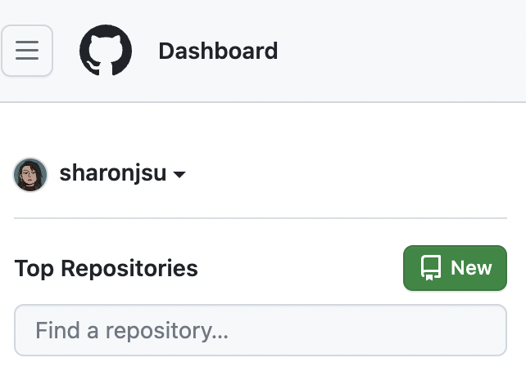
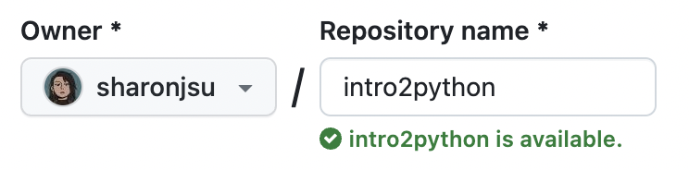
Github Tutorial time!!!!
go to github.com and make a new repository titled ‘intro2python’
Notes:
What is a repository? A repository (or repo) is a type of centrally located storage where you can keep all your project's files and resources. We will be making one for the git tutorial today.

Slide 22
Git Tutorial time!!!!
Step 1: open your terminal of choice
Step 2: confirm that you have git installed by typing into your command line
> git
windows users:
> git init
if you get an error such as `command not recognized` then you may not have installed git in the current environment.
> conda activate intropython
> git
Notes:
11:20AM
move on after 2 mins
Should they raise their hands?
STICKY NOTE IF UR SHIT DOESNT WORK grab a TA!!

Slide 23
Git Tutorial time!!!!
Step 1: open your terminal of choice
Step 2: confirm that you have git installed by typing into your command line
> git
windows users (if the above does not work):
> git init
if you get an error such as `command not recognized` then you may not have installed git in the current environment.
> conda activate intropython
> git
Notes:
11:20AM
move on after 2 mins
STICKY NOTE IF UR SHIT DOESNT WORK grab a TA!!

Slide 24
Git Tutorial
step 0: > cd documents
step 1: > git clone git@github.com:<username>/intro2python.git
Or
git clone https://github.com/<username>/intro2python.git
Cloning into 'intro2python'...
warning: You appear to have cloned an empty repository.
step 2: >cd intro2python
Ignore these next 2 steps for now Sharon will explain in a sec
step 3: >ls
step 4: >ls -a OR ls -Hidden
Notes:
When you clone a repository, it creates a new folder in your current PATH. For those who don’t know what a path is, you can think of it as the folder, aka the directory, that you are telling the terminal to do things in. That folder will contain all the files from the repository you cloned. So, then we can use the cd command, to change into that directory, aka that folder.

Slide 25
Git Tutorial
step 1: open up VS code and make a new file
File>New File>Python File
step 2: in the file, type:
print(‘hello pals!’)
step 3: save as ‘hello.py’ in your cloned repository path
Notes:
11:22AM->11:27
go to step 2 btw

Slide 26
Git Tutorial
step 1: open up VS code and make a new file
File>New File>Python File
step 2: in the file, type:
print(‘hello pals!’)
step 3: save as ‘hello.py’ in your cloned repository path
step 4: open up vscode terminal
step 5: cd to save path
step 6: check to see your file is there
>ls
hello.py
step 7: run your program
>python hello.py
windows users: py hello.py
hello pals!
Notes:
11:22AM->11:27
5 mins
STICKY NOTE TIME

Slide 27
Git Tutorial - Commit
in VS code terminal, run the following commands in order
>git status
>git add hello.py
>git status
>git commit -m ‘my first commit!’
>git push
check to see your file online by going to your github repository
Notes:
All I showed was esc then :w :q to get out of it if they accidentally don't include -m. git commit -m "my commit message" lets them commit without dealing with vim.
11:27AM->11:35 AM
STICKY NOTE TIME

Slide 28
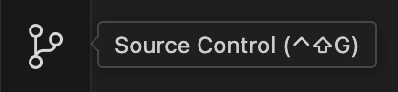
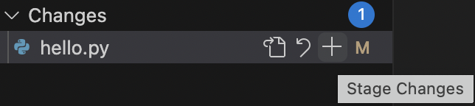
Git Tutorial - VS code
edit your hello.py file
print('hello pals of the world!')
navigate to source control tab
stage changes
type commit message and hit the commit button
Notes:
11:36AM->11:37

Slide 29
Jupyter Notebook overview
Example jupyter notebook is shown
Benefits:
Live code
Easier debugging
Can go step by step, easy to document what each step is doing via markdown cells
Notes:
11:43 - 11:47

Slide 30
Jupyter Notebook tutorial
Create and run a jupyter notebook, ensuring you have selected the “intropython” environment kernel
create and run 3 cells, making sure none of them output errors:
markdown cell
# hello world
code cell
print(‘hello world’)
code cell
import numpy
2. Save notebook as “helloworld.ipynb” and commit to the repository.
Notes:
Markdown cells allow you to write plain text and format it using the Markdown syntax rules. This type of cells also supports standard LaTex notation so you can include mathematical symbols in your text. Markdown cells usually serve as explanatory or descriptive texts to your code.
Code cells allow you to run code snippets.

Slide 31

Exit Tickets
Please fill them out before you leave or else we will be very, very sad
No major HW for class 2!
Notes:
11:57

